Slide 1
Application Programming Interface
Module Project
Module: Application Programming Interface
Start Date : 29th January 2023
End Date : 30th January 2023
Submission Date : 30th January 2023
Learner Name : W.A. Hashini Sewwandi
Enrollment ID :
Presentation Date :

Slide 2
Contents
Contents
S. No. | Description
01 | List of Tools used
02 | What is API?
03 | What is the role of API?
04 | The range of APIs for a particular platform
05 | Potential Security issues with API
06 | The project requirements
07 | Project Demo
08 | The Strengths of Project API
09 | The Weakness of Project API
10 | Security Report
11 | Review and reflect the application development

Slide 3
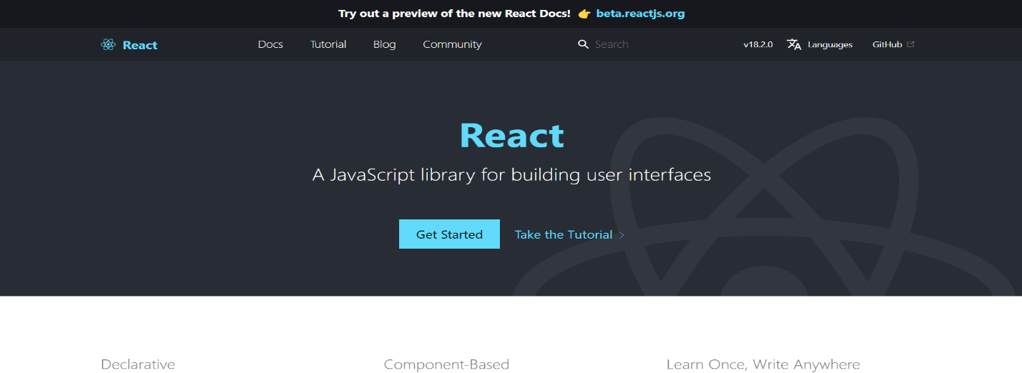
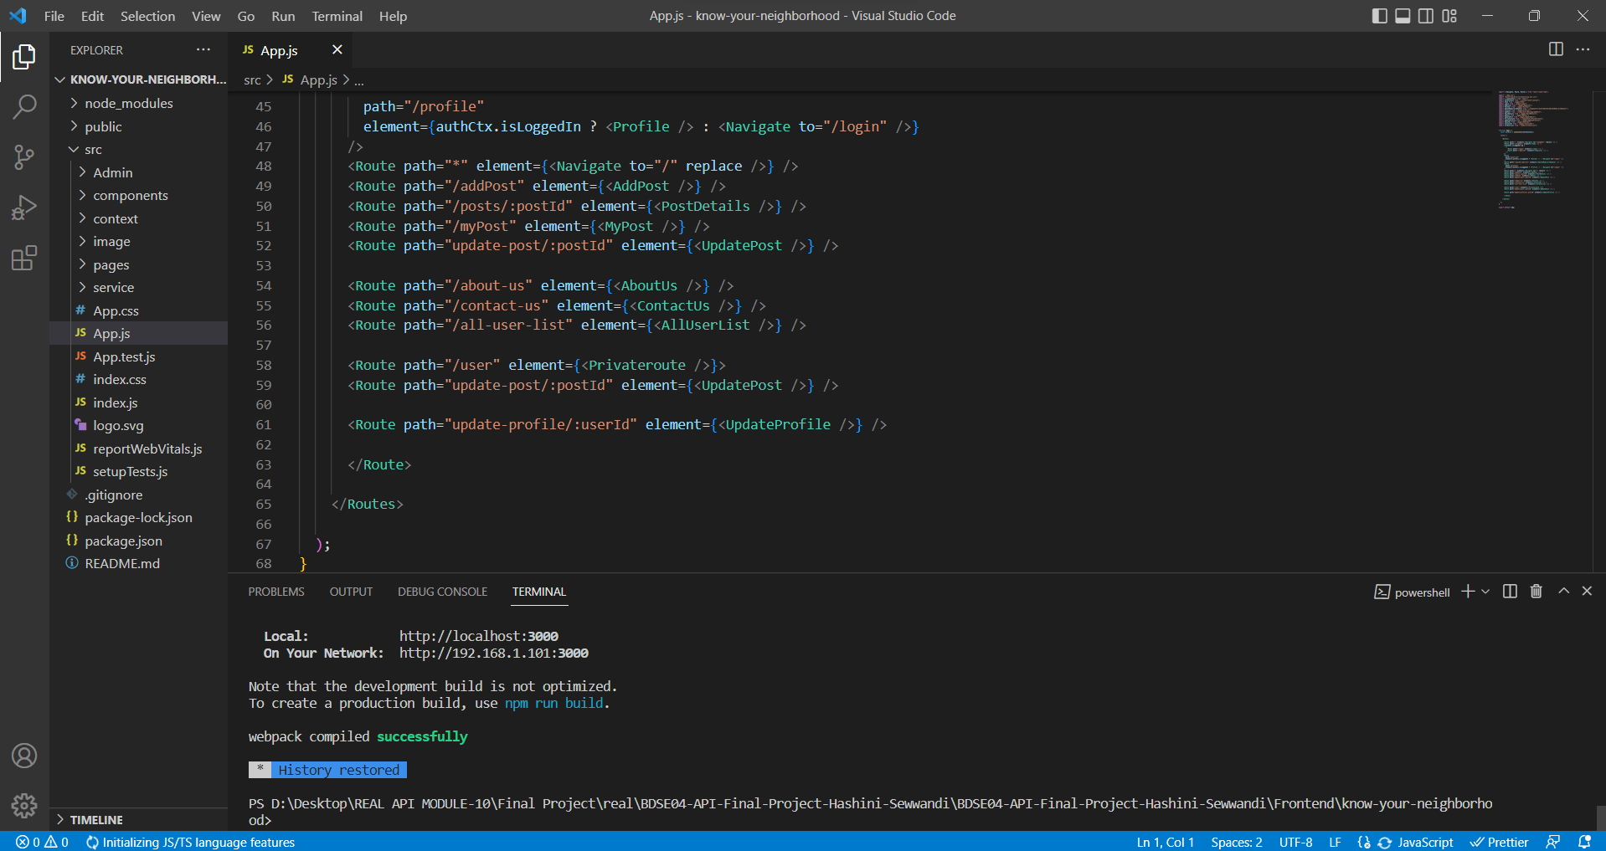
1. List of Tools used
React JS
Visual studio code

Slide 4
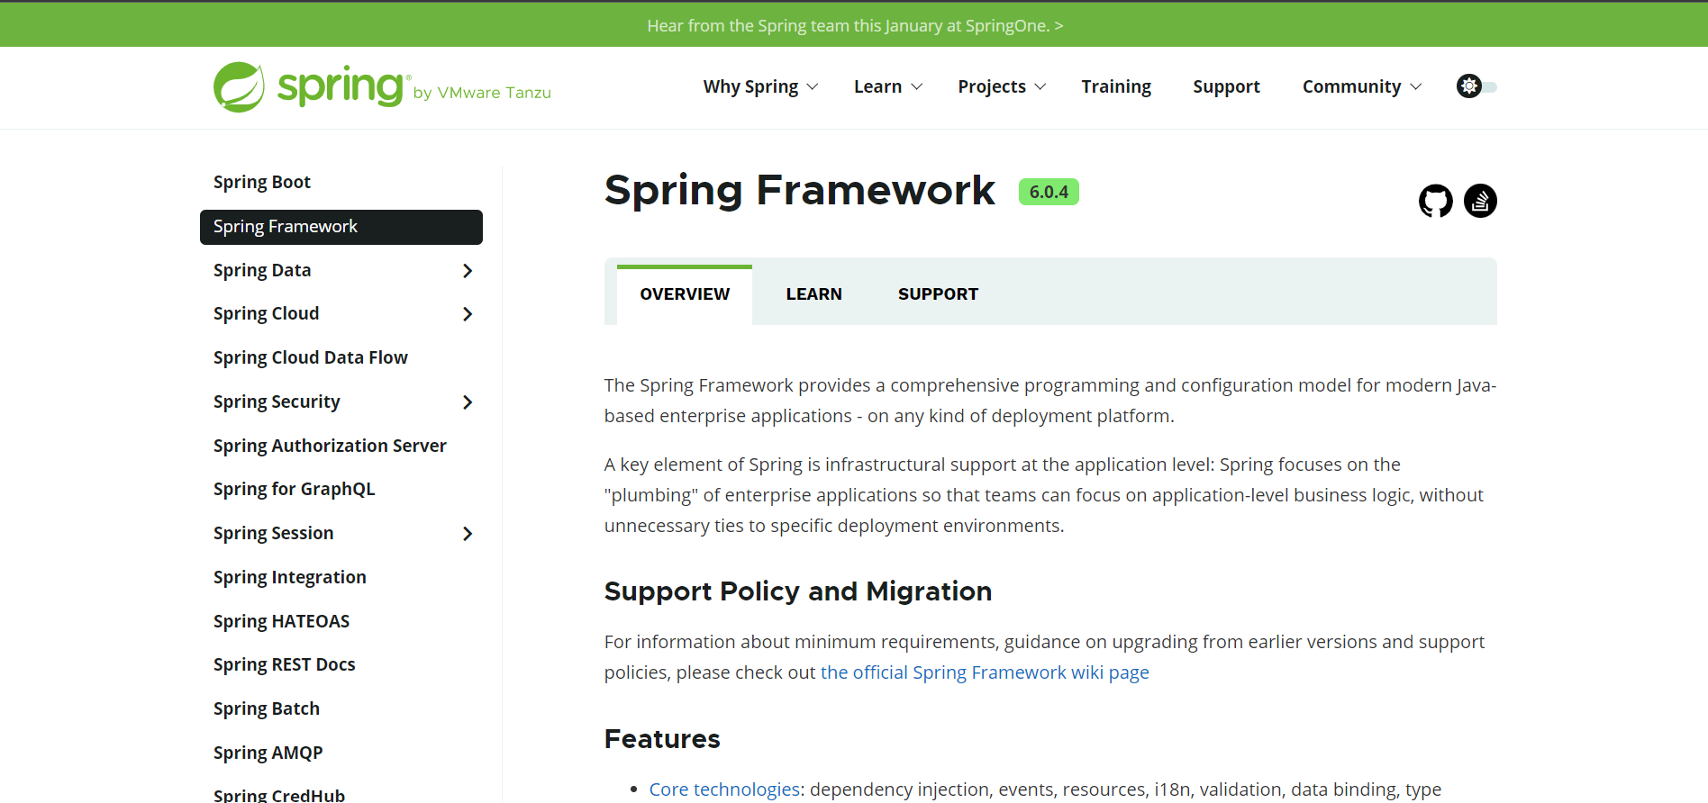
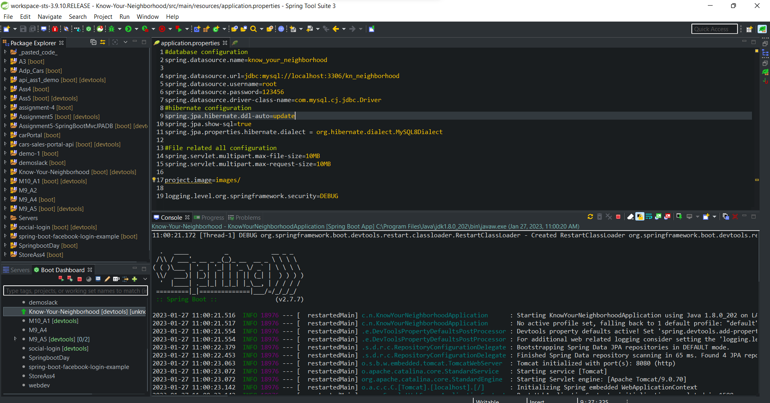
1. List of Tools used
Spring Boot Framework
STS IDE

Slide 5
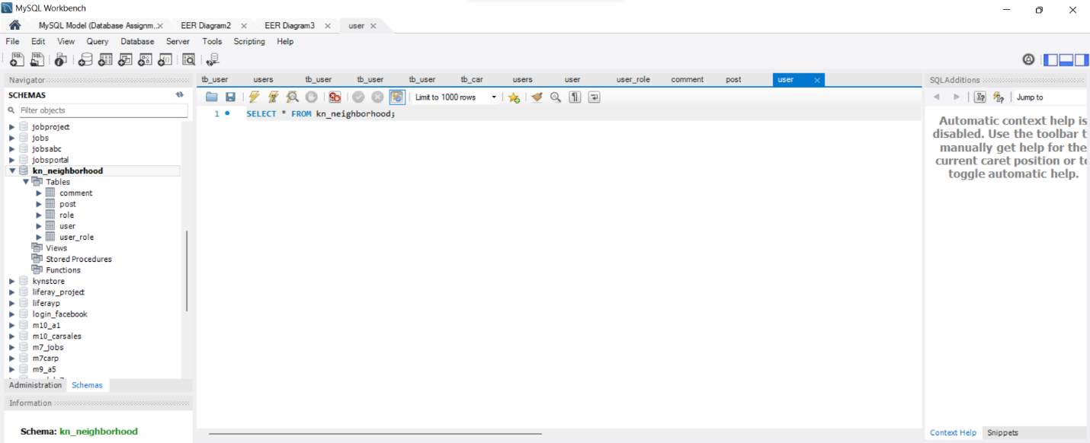
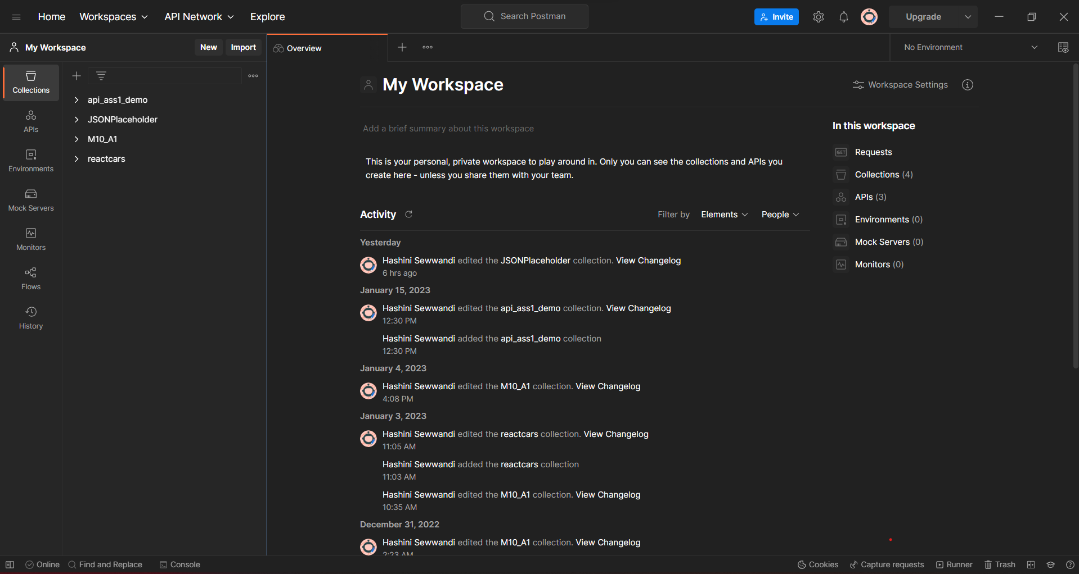
1. List of Tools used
MySQL Workbench
Postman

Slide 6
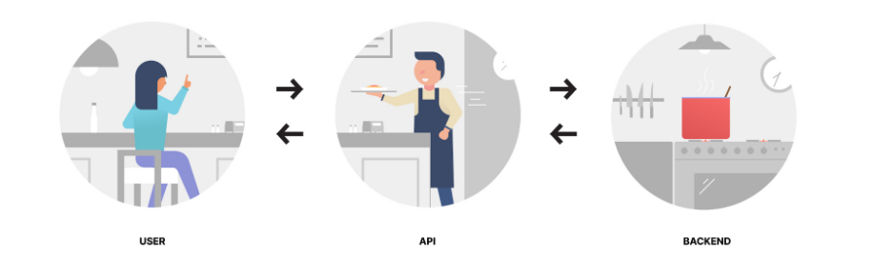
2. What is API?
An application programming interface, or API, is considered a software-to-software interface. Applications use APIs, or Application Programming Interfaces, to work with each other and provide a secure and standardized way to provide requested information or functionality without user intervention.

Slide 7
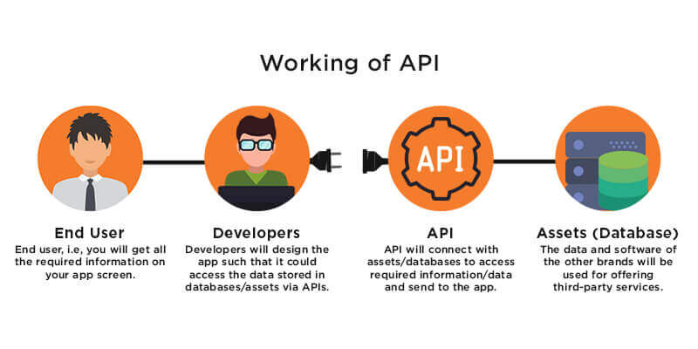
3. What is the role of API?
APIs are important for companies to deliver more value to customers in less time as expectations for a seamless user experience grow. Also by using APIs to access another company's data, piece of code, software or services, you can save time and money and extend the functionality of your own product. And this is essential to stay agile in the market, to meet and anticipate the increasingly sophisticated needs of consumers.

Slide 8
4. The range of APIs for a particular platform
Considered private APIs, APIs are only available to internal company teams to increase productivity and transparency. Developers working for the company can use this API on demand, but third-party inventors cannot.
Partner APIs participate externally, but only with those who have a business relationship with the company providing the API. Some businesses use partner APIs because they want to control who can access their resources and how they can use them.
Internal APIs, Internal API is developed only for internal community use. For instead, internal APIs may connect to organization rollcall or HR system.
Composition API allows you to combine calls or requests from multiple servers to get a single response. However, if you need data from multiple operations, you use the composite API. Or, instead of making five separate API calls in sequence, you can make one using API compounding.
.

Slide 9
5. Potential Security Issues with APIs
There are several types of security issues that can arise with APIs.
Injection Attack
DDoD Attacks
Broken Authentication
Sensitive Data Exposure
Broken Access Control
Parameter Tampering
Man-In-The-Middle-Attack

Slide 10
6. The Project Requirements
1. Functional Requirements
User can able to register an account.
User can log through API links.
User can retrieve user information once user has login.
User can login through third-party services, such as Facebook should be configured.
2. Non-Functional Requirements
Maintenance Requirements
ReactJS software and spring boot API internet offerings not dependent to every other.
ReactJs application must have its personal components folder, resources, utils and more for the of clarity

Slide 11
6. The Project Requirements
Security Requirements
User password can hashed to store in database.
Authentication manner can stateless and followed token-based authentication.
OAuth2 authentication for facebook can configured
Performance Requirements
Loading common time for all pages must be at most 1.0 second.
Uptime of net application need to be ninety nine.99%
Dashboard have to be scalable as much as 10K users.
Portability Requirements
Rest API ought to have ability to call from any internet programs.
ReactJS application need to be compatible with any sort of browser from any working structures.

Slide 12
6. The Project Requirements
Home Page – index page for public user.
Registration Page – for user to register.
Login Pages with API link – for user to login with local or other services.
Contact us Page – to display to contact information of company.
About us Page – to display biography and team information of company.
Teams and Conditions page – to display teams and conditions for user to follow before registration.
Dashboard/ Teams and condition. – To display user information after login successfully.

Slide 13
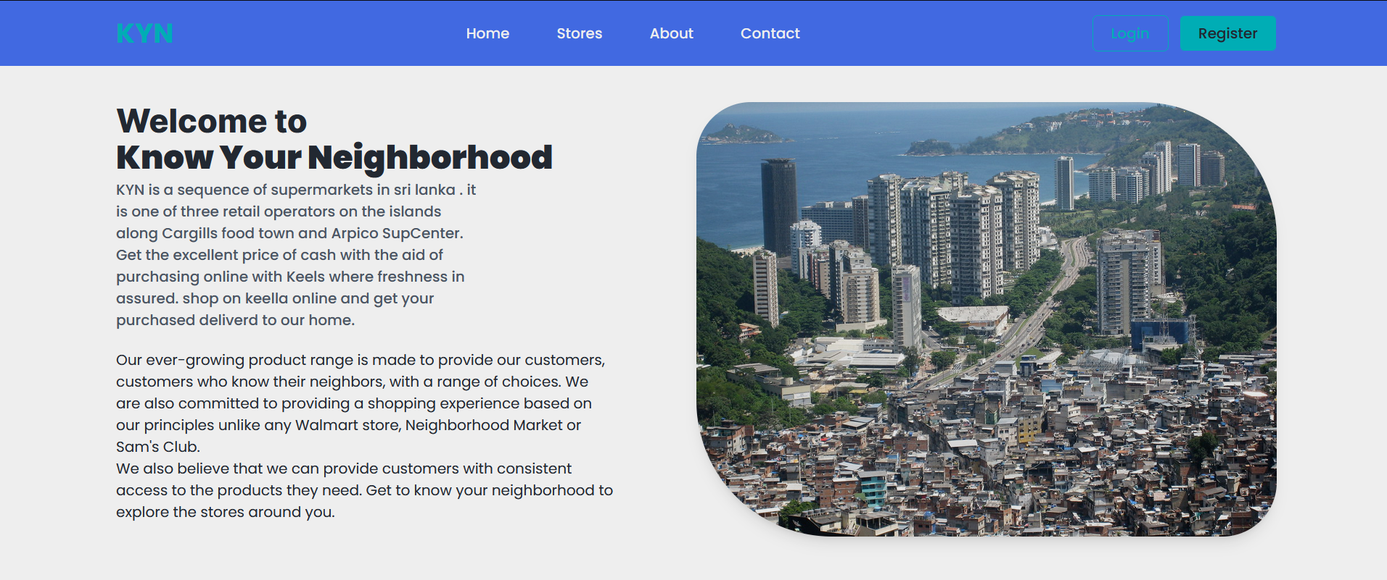
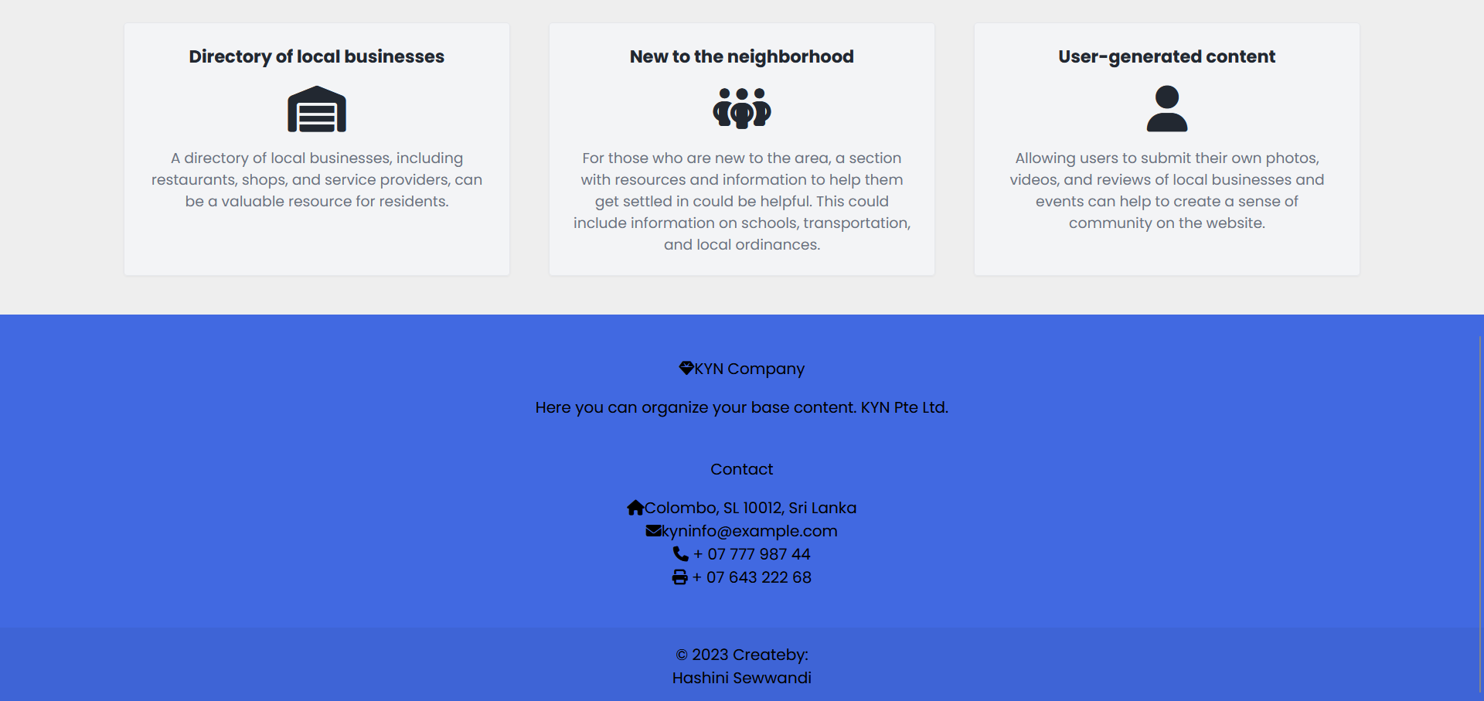
7. The Project Demo
Home page

Slide 14



7. The Project Demo
About Us Page

Slide 15
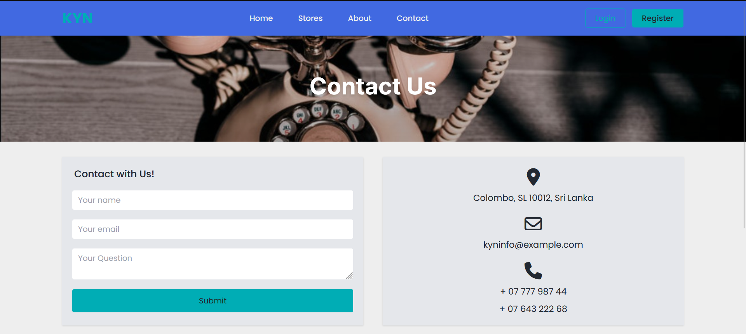
7. The Project Demo
Contact Us Page

Slide 16
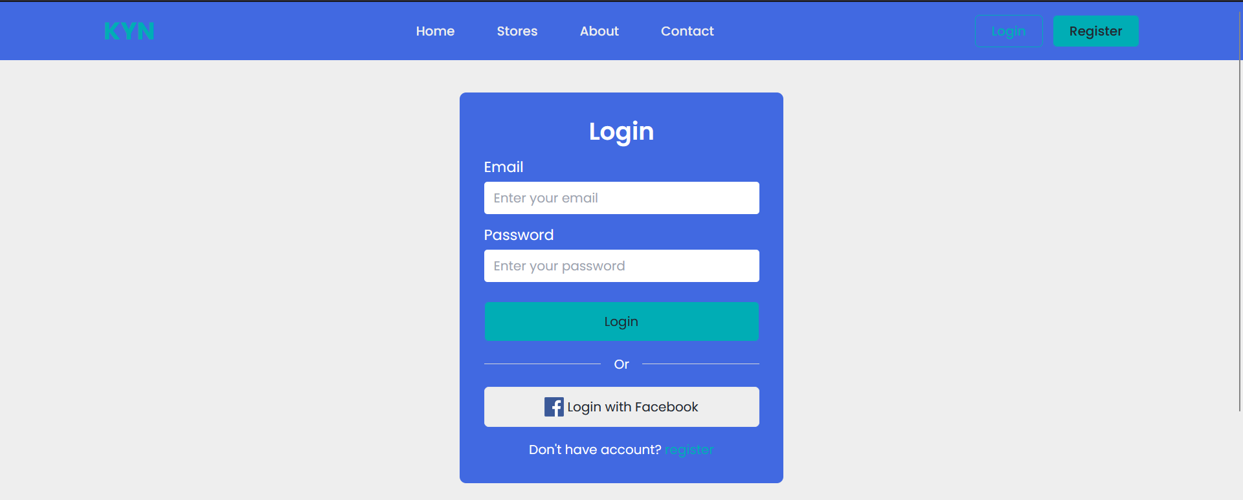
7. The Project Demo
Login Page

Slide 17
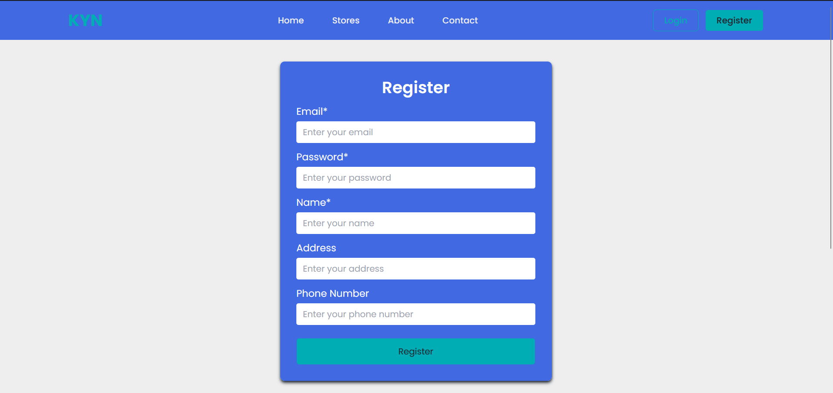
7. The Project Demo
Register Page

Slide 18
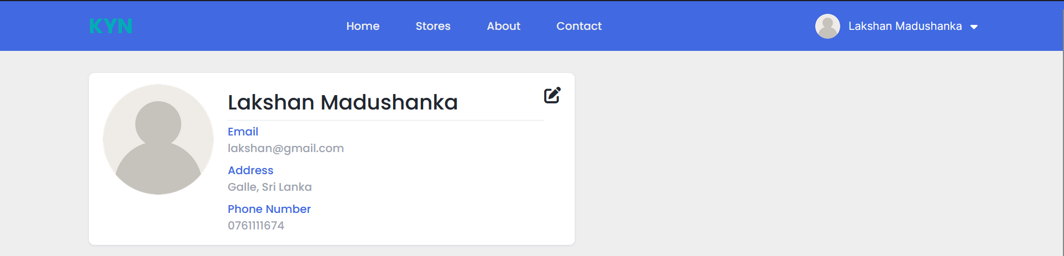
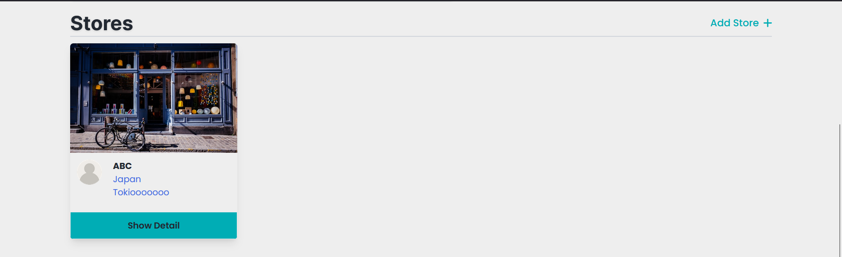
7. The Project Demo
Profile

Slide 19
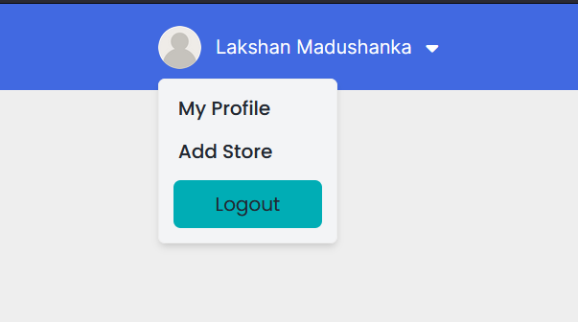
7. The Project Demo
Logout Page

Slide 20
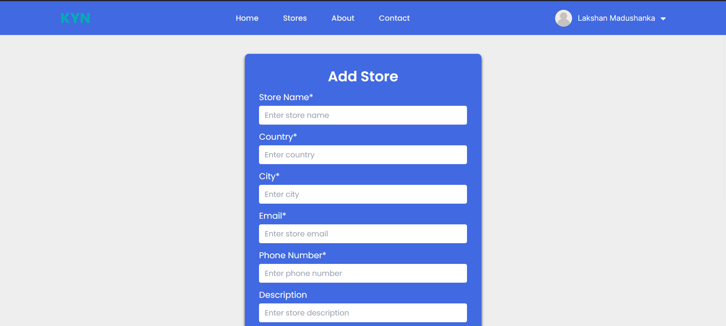

7. The Project Demo
Add store Page

Slide 21
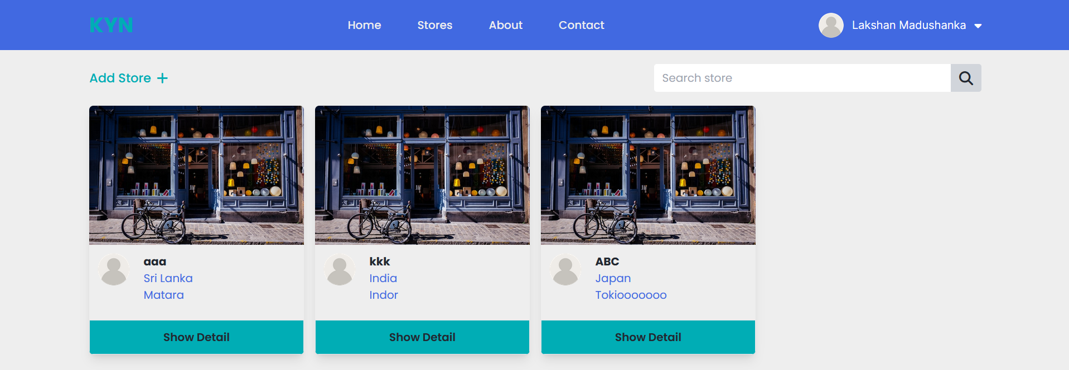
7. The Project Demo
Store page

Slide 22
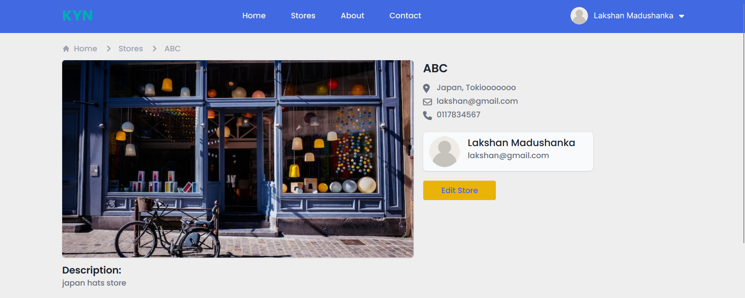
7. The Project Demo
Store details

Slide 23
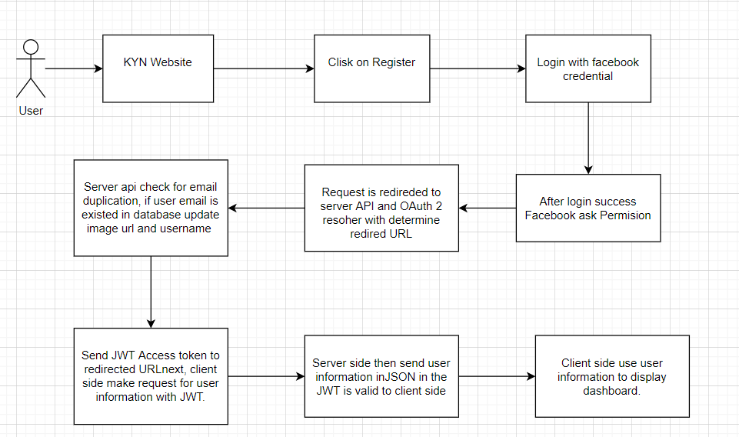
8. The Strengths of Project API

Slide 24
8. The Strengths of Project API
As in image above, user has logged in registered to the KYN website. First, users click on the register button. Then redirected to respective authentication login web page. After user had furnished credentials information. User might be requested to give permission to KYN web application. After given the permission, server OAuth2 user detail carrier authenticate user with statistics from local database.
If user is already existed in database, then update in present username and profile URL. In any other case, create new user row. After authentication, server API generate JWT token and attach at the side of redirect URL. As the redirect URL is client side, client acquires given JWT. Then client requests for user information from database with given JWT. If JWT is valid, client receives the user statistics and presentations dashboard.

Slide 25
9. The Weaknesses of Project API
Strengths and Weakness selected API, features.
The principle benefit of using decided on API is Authentication by way of spring security applications. Damaged get admission to manage may be avoided as application used token-based authentication method. Furthermore, OAuth2 authentication even provides more reliable and quicker authentication so that to make application technique sturdy. By means of the usage of select API, any frontend application with goal domain name can make API calls and make authentication technique. API is constructed in rest architectural, as an end result, representation or information transfer from API is formal and standard for consumer to observe.

Slide 26
9. The Weaknesses of Project API
main feature of API isn't allow user information from third-party to store in database and OAuth2 authentication could make user experience higher so that business leads can boom.
Weakness of selected API is the use of HTTP protocol rather than HTTPS encryption. JWT is connected in request header as a Meta information. Malicious person could make guy-in-middle attack through which JWT can be received. Through HTTPS, request from customer aspect can be encrypted with public key and private key.

Slide 27
10. Security Report
Created KYN application using backend API Spring Security pre-built libraries and tools for project instance. Security features such as Spring Security authentication and authorization allow Spring Security packages to be tested multiple times to ensure that they are valid and that there is no risk of security misconfiguration.
Security with OAuth
A third-party authentication server from Facebook or google provides secure functions at the authentication layer and abstraction for the API. With OAuth2, security risks can be reduced because of experienced and useful security filters from OAuth2 services.

Slide 28
10. Security Report
Authentication with JWT
API with JWT offers a stateless authentication benefit as the server does not want to store any session identification key like consultation based authentication. Damaged get admission to manage can be avoided with JWT security filter. Injection attack is minimized as API uses Hibernate framework and spring records applications. The attacker cannot enter any command or query to change the execution of the program.

